Slide 1
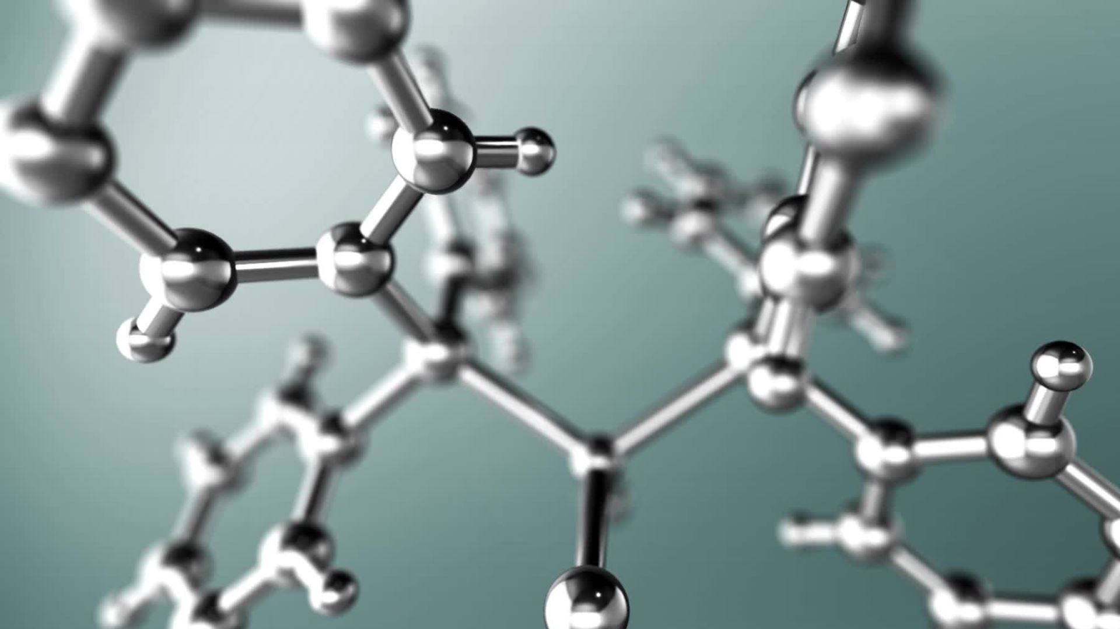
Lattice-based Cryptography
Chanikya Prakash 210050053

Slide 2
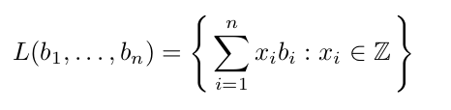
Basic structure of a lattice:
What is lattice-based Cryptography?
The schemes whose security is based on solving some well-known hard problems like SVP.
Why is it important?
Well, in the post-quantum era many known schemes were broken easily by quantum computers
So, we need something Stronger.

Slide 3
What's our hope in lattice-based problems?
There are currently no known quantum algorithms for solving lattice problems that perform significantly better than the best-known classical (i.e., non-quantum) algorithms.
So, can we put our belief in this?
Well, it might be broken in future.
The only hope to try solving these problems is that the lattice problems are believed not to be not NP-Hard because of their periodic structure.

Slide 4
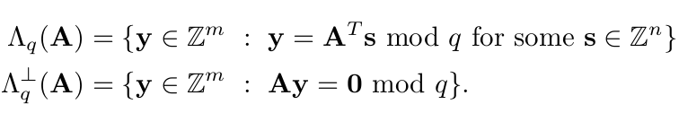
What are q-ary lattices?
The lattices in which the membership of a vector x in L is determined by x mod q
These are of particular importance in lattice-based cryptography
The below q-ary lattices corresponds to the code generated by the rows of A(any q-modular matrix sampled from Z^{m*n} ) & code for parity check

Slide 5
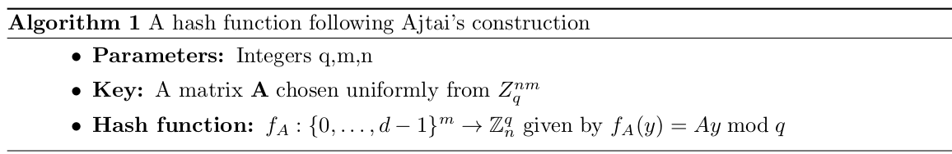
Can we construct hash functions based on hardness of lattice?
Ajtai's Hash function
Construction is pretty simple & the invertibility of this hash function is directly related to finding a short vector in parity check code lattice (Λ⊥(A))
Nevertheless, these hash functions are not particularly efficient because the key size grows at least quadratically in n.
So, we can't use this in practice

Slide 6
Can we improve/build more efficient hash function?
Idea: We can use special structured matrices to increase efficiency, How?
Mainly, we will discuss about cyclic and ideal lattices
Cyclic lattices:
In this, each column is a cylindrical rotation of the first column. This can be achieved by defining a permutation matrix T
With this update, we can reduce the running time from O(mn) to just O(n).
Security came for free?
NO!
It was observed that, collisions can be found in O(q) time

Slide 7
Ideal lattices:
Everything was except the permutation matrix, the last column in T was (1,0..,0) it was replaced by –f(arbitary vector which satisfies some properties)
So, to the main point! Is it Collision-resistant?
YES!
But, f should satisfy the below properties:
For any two unit vectors u, v, the vector [F∗u]v has small (say, polynomial in n) norm
The polynomial f(x)=x^{n}+fnx^{n-1}+⋯+f1∈Z[x] is irreducible over the integers, i.e., it does not factor into the product of integer polynomials of smaller degree

Slide 8
Now, lets see how we can construct PKE schemes based on lattices.
Basically, there are theoritical (which has strong proof of security but can't be used in practice) & practical(which can be efiiciently used in practice but lacks security proof)
For the start, we will discuss about GGH/HNF public key cryposystem

Slide 9
The GGH/HNF public key cryptosystem:
The private key is a “good” lattice basis B. Typically, a good basis is a basis consisting of short, almost orthogonal vectors.
The public key is a "bad" lattice basis H. H is the Hermite normal form of B (analogue of reducedr echelon form).
Encryption: Given a message m = (m1,m2,…,mn),error e,Public key H, cipher text c = m.H+e
Decyption: Given a cipher c, private key B, message = c.B⁻¹U⁻¹
Assuming, e is very small for applying Babai's approximation

Slide 10
Is this scheme secure?
The security relies on the assumption that without knowledge of a special basis , solving these instances of the closest vector problem (CVP) in L(B) = L(H) is computationally hard.
As you already observed, this scheme is not completely secure because it is deterministic
We can solve this by randomly pad the message (as is often done with the RSA function)
To prevent attacks, we should use much larger key which makes this scheme impractical

Slide 11
The LWE-based cryptosystem (Just brief Intro.)
It is perhaps the most efficient lattice-based cryptosystem to date supported by a theoretical proof of security.
The cryptosystem was shown to be CPA secure based on the conjectured hardness of the learning with errors problem (LWE)
The input is a pair (A, v) where A ∈ Z^{m×n} is chosen uniformly, and v is either chosen uniformly from Z^{m} or chosen to be As + e for a uniformly chosen s ∈ Z^{n} and a vector e∈Z^{m} chosen according to χ^{m}
The goal is to distinguish with some non-negligible probability between these two cases.

Slide 12
Why it is hard?
A reduction from worst-case lattice problems such as approximate-SVP and approximate-SIVP to LWE was established indicating that it is indeed hard.
Point to Note: This is a Quantum reduction. Breaking this system is indeed giving a quantum algorithm to general SVP
It is stronger as it is based on the general SVP and not the special case of unique-SVP

Slide 13


